Slide 1
Advanced usages of Flux
Emanuele Della Valle
Prof. @ Politecnico di Milano
Founder & Partner @ Quantia Consulting
Marco Balduini
Riccardo Tommasini
Prof. @ University of Tartu

Slide 2
Manipulate timestamps

Slide 3
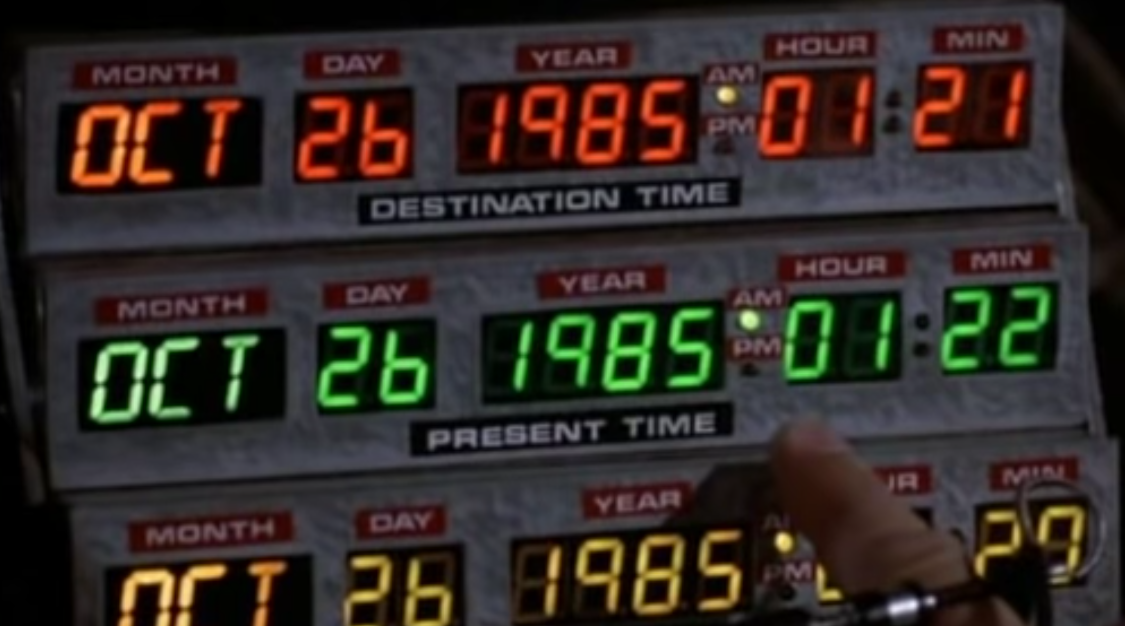

Slide 4
Manipulate timestamps
Every point stored in InfluxDB has an associated timestamp.
Flux can process and manipulate timestamps:
Normalize irregular timestamps
Convert timestamp format
Calculate the duration between two timestamps
Use timestamps and durations together

Slide 5
Convert timestamp format
time() converts Unix nanosecond to RFC3339
time(v: -446090160000000000) // Returns 1955-11-12T22:04:00.000000000-07:00
unit() converts RFC3339 to Unix nanosecond
uint(v: 1955-11-12T22:04:00.000000000-07:00) // Returns -446090160000000000

Slide 6
Calculate the duration between two timestamps
Flux doesn’t support operations among time values
To calculate the duration between two timestamps:
Use the uint() function to convert timestamps to a Unix nanosecond
Subtract one Unix nanosecond from the other
Use the duration() function to convert the result into a duration
E.g.,
time1 = uint(v: 1955-11-12T22:04:00.000000000-07:00)
time2 = uint(v: 1955-05-12T07:00:00.000000000-07:00)
duration(v: time2 - time1)
// Returns 6d15h4m

Slide 7
Use timestamps and durations together
experimental.addDuration() adds a duration to a timestamp
experimental.subDuration() subtracts a duration from a timestamp
import "experimental”
experimental.addDuration(
d: 6d15h4m,
to: 1955-05-12T07:00:00.000000000-07:00)
// Returns 1955-11-12T22:04:00.000000000-07:00
experimental

Slide 8
Time Series Enrichment

Slide 9
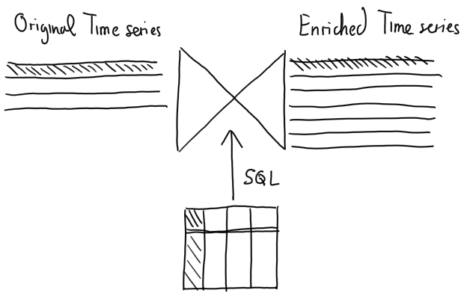
Time Series Enrichment – the intuition
I4.0 apps
IoT Sensors
Enterprise Resource Planning
9

Slide 10
Use case for the Linear Pizza Oven
Enrich the IoT observations with the ID of the pizza and the kind of pizza contained in the Enterprise Resource Planning RDBMS
This enables:
In the short term, full traceability of cooking conditions for each pizza
In the long term, prescriptive analytics for pizza quality control
Easy: control the pizzas that were in the oven when anomalous temperature alter went off
Hard: build a classifier that alerts for quality issues based on the past observations

Slide 11
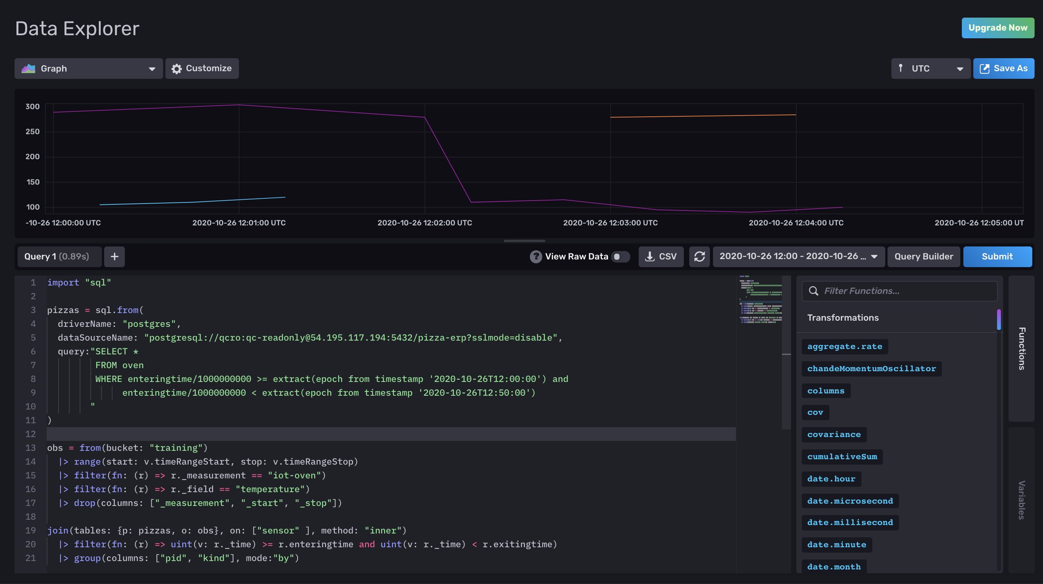
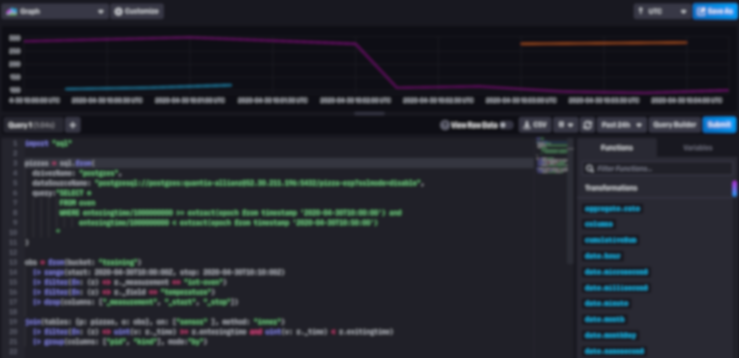
Time Series Enrichment in Flux
11

Slide 12
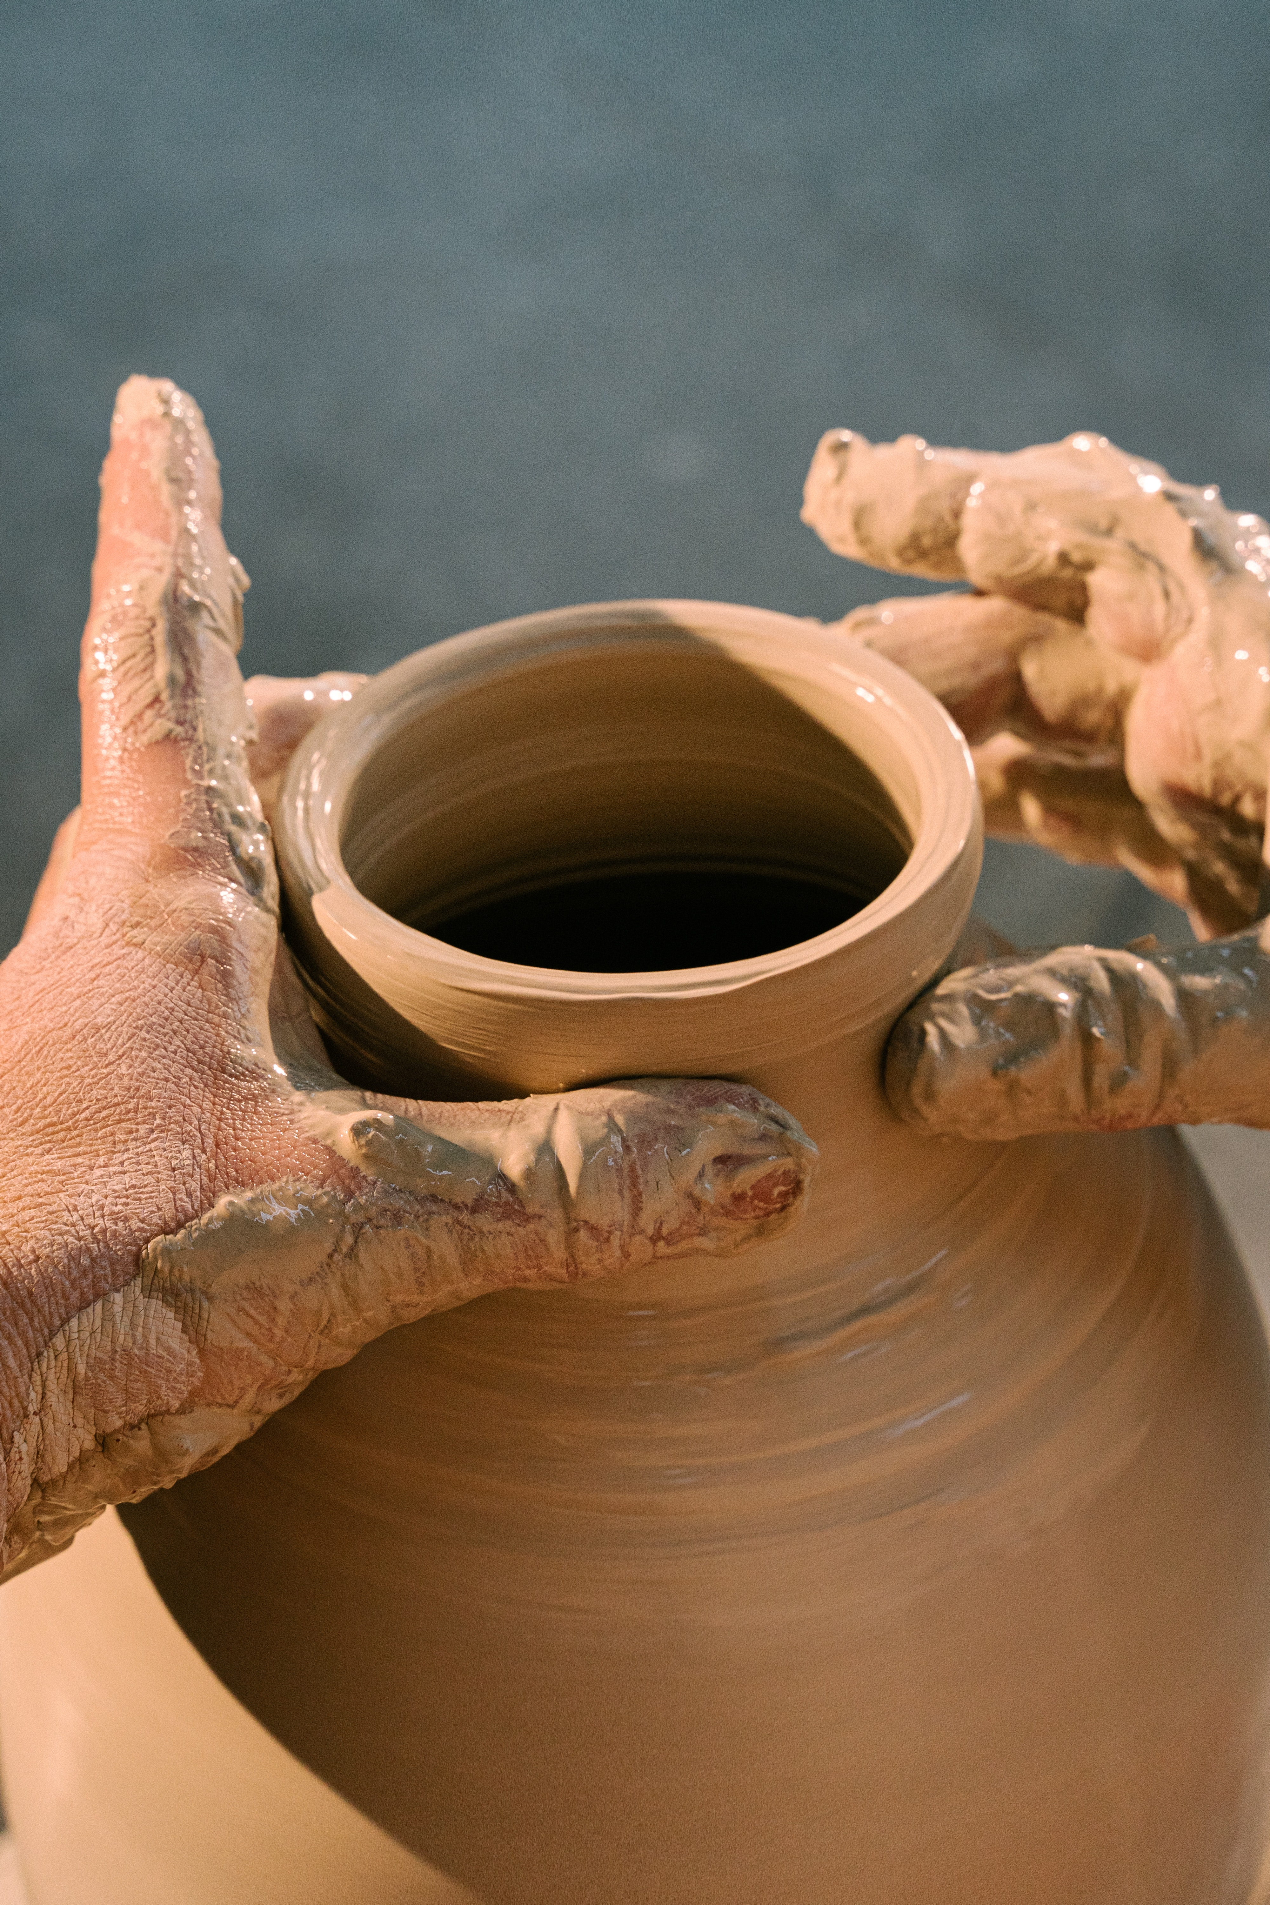
Let me explain it …

Slide 13
Advanced Time Series Analytics

Slide 14
Holt-Winter’s method
Given a time series
It is often possible to extract
a trend: a long term variation of the time series.
a seasonality: a short term recurring pattern
What is left is call residual
14

Slide 15
Forecasting with Holt-Winter’s method
Data
Fitted
Forecast
Lower 2,5%
Upper 97,5%
15

Slide 16
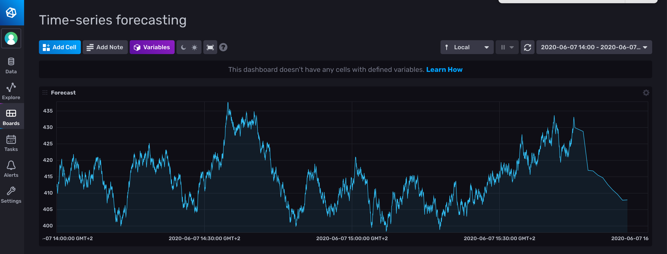
Holt-Winter’s in Flux
16

Slide 17
Holt-Winter’s in Flux
from(bucket: "training")
|> range(start: v.timeRangeStart, stop: v.timeRangeStop)
|> filter(fn: (r) => r._measurement == "fill_level")
|> filter(fn: (r) => r._field == "value")
|> filter(fn: (r) => r.tank == "B2")
|> aggregateWindow(every: 1m, fn: first)
|> holtWinters(n: 10, seasonality: 8, interval: 1m)

Slide 18
What (else) can I do with Flux?

Slide 19
What (else) can I do with flux?
Map/Reduce
Derivative, Difference, Integral
Histograms
Regular expression matching
String functions
Go Math library parity
Quantile
Conditional expressions
Sorting
Data Generation
In-language test assertions
…
And more every day!
19

Slide 20
Advanced usages of Flux
Emanuele Della Valle Prof. @ Politecnico di Milano & Partner @ Quantia Consulting
Marco Balduini Founder & CEO @ Quantia Consulting
Riccardo Tommasini Prof. @ University of Tartu

